Slide 1
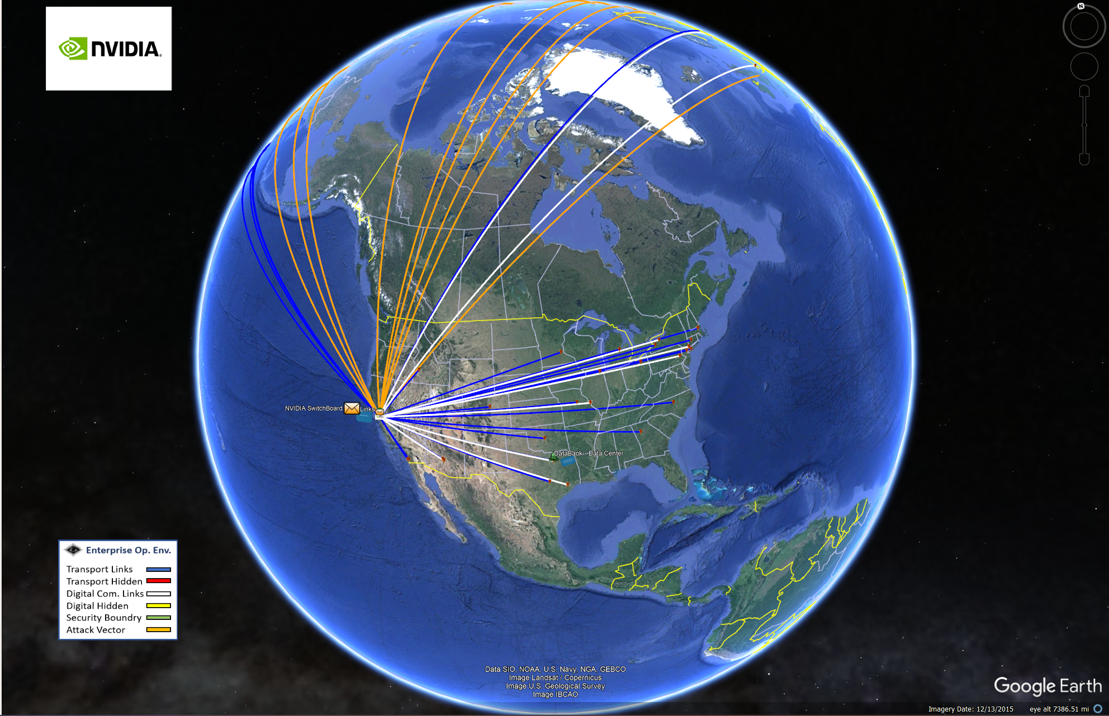
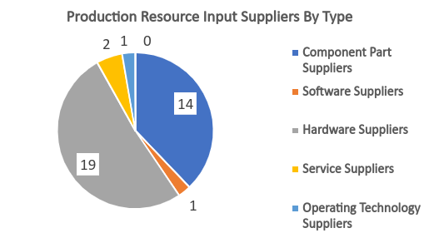

Managing Supply Chain Cyber Risks
CYBR 437
Security Goal and Objectives
Overarching Goal: No operational impairment resulting from a cyber-attack on the enterprise supply chain
Objectives:
No insecure interaction with suppliers
No supplier will be utilized without meeting minimum security or requirements Or signature of a qualified manager
No internal development project support without considering security design requirements
No counterfeit, tainted, and malformed digital product purchases
No supplier will be operationally impaired by a cyber-attack causing an interruption of supply.
No use of a supplier as an indirect attack-vector for staging a cyber-attack
It is impossible to defend a supply chain if you cannot visualize and describe it!
Cyber Risk Management Strategy
Identify, assess, mitigate, and monitor risks related to their digital assets and operations
Understanding of potential threats, vulnerabilities, and impacts on the organization's objectives, and then applying controls accordingly
In the context of Nvidia's supply chain model, features of the strategy would include
identifying all potential cyber risks across the supply chain
third-party suppliers
software supply chain
digital goods and services
this could include risks such as insertion attacks, counterfeit products, or vulnerabilities in software components
Assessing likelihood and impact of risks
Choose risk response (avoidance, transference, mitigation, acceptance)
Implementing controls if response is mitigation
Continuous monitoring of controls
GIS Supply Chain Model
Supply Chain Model Analytics
Spring 2024
Notes:
Instructions for printing – larger 24x32 poster for wall hanging
You must print from the print station in CG 2035. You must configure the Printer Settings properly to get the appropriate size poster:
From PowerPoint, go to Print.
The printer “Hewlett-Packard HP Designjet T520 24in” should already be selected.
Click the “Printer Properties” link under the printer drop-dop
In the “HP Designjet Printing Preferences” dialog box, select the “Document size” drop down and pick ”Custom” at the bottom.
Set width 24 and height 32. Give it the name “24x32” and save.
Ensure your new 24x32 is selected in the Document Size drop down in the main dialog window.
Set “Paper source” to Roll
Select the left button under “Margin layout”
Set ”Color mode” to color (first button)
Set “Print Quality” to normal
I recommend clicking the toggle button “Show preview before printing” on the right side.
Print when ready. If you need to edit and re-print, ensure your preset “24x32” Document Size is selected.

